Slide 1
Online Learning

Slide 2
Group Members:
Ahmed Ali
Hakim Nabi
Zarqa shehwar
Malik Abdullah
Arslan Abid
Mubashir

Slide 3
WHAT IS ONLINE EDUCATION:
Online student and teacher Interaction over internet
Wide Access Anytime & Anywhere
Back in the day, classrooms meant only physical classrooms.
But, online classrooms have gained immense popularity, especially after the emergency of the COVID-19 pandemic.

Slide 4
Shy students may feel more comfortable
Some students hate to participate in live class discussions, for them the online environment can be less intimidating.

Slide 5
Positive affects of online learning
Increased Course Variety
Online Courses are Convenient
Enhances Self-Discipline
Self Esteem Enhanced
Online learning makes it possible to keep your job
It’s easier to concentrate and participate

Slide 6
BENEFITS:
Provides a Safe & Comfortable Environment
Complete Flexibility
Cost-Effective
Less Effort

Slide 7
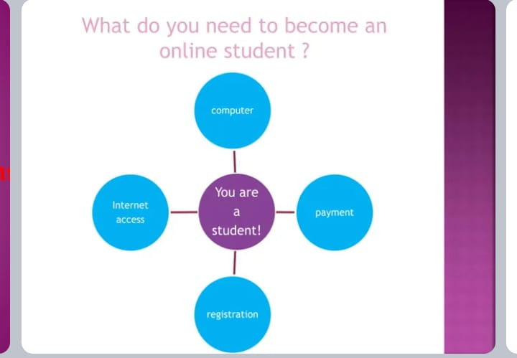

Slide 8
Negativities
Only few people take admission (approx. 1%-2%).
High rate of students leaving the course.
Low level of eagerness to participate. Ng
Negligence and Irresponsible behavior.
Less rules.
Distractions

Slide 9
Lack of control
The teacher has no possibility to control you properly.
Lack of Motivation.
Lack of discipline.
Lack of person interaction

Slide 10
Employment
Not many industries will acknowledge an online professional degrees
Lack of Skills and Technical Issues.
Poor Communication

Slide 11
Future
65% post-secondary institute providing college level online courses.
Large number of schools from western countries participating.
Most of the websites i.e.(coursera , cybrary)offers paid courses .

Slide 12
Business probability:
Big companies are investing.
Google Capital invest $40 million in online education giant Renaissance Learning.
Online education giant Khan academy's revenue as per 2012 data 15.795 million USD.
User of edX (provider of MOOC) - more than 5 million.

Slide 13
CONCLUSION
Education is essential for all.
However, different people have different preferences when it comes to selecting the most suitable mode of education
. Online classroom vs. Physical Classroom is an ongoing debate for several people.
Sometimes, it gets challenging to pick the appropriate form of the classroom for yourself or a child.

Slide 14
Thank you!

